Slide 1
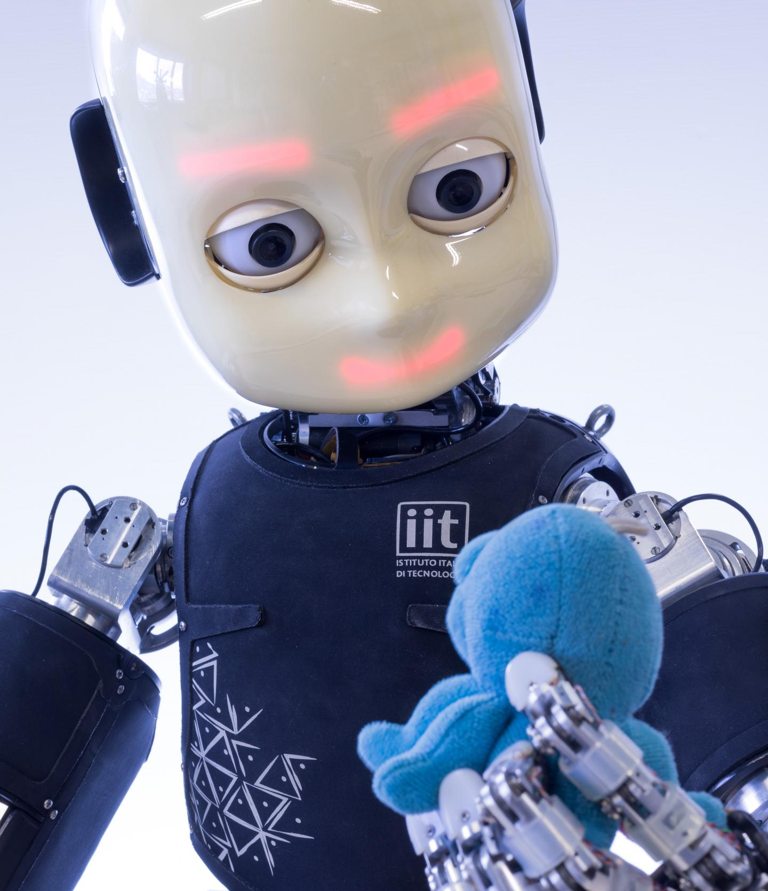
Icub Tech facility
Marco Maggiali, https://github.com/orgs/icub-tech-iit/people

Slide 2
Icub – ARChitecture

Slide 3
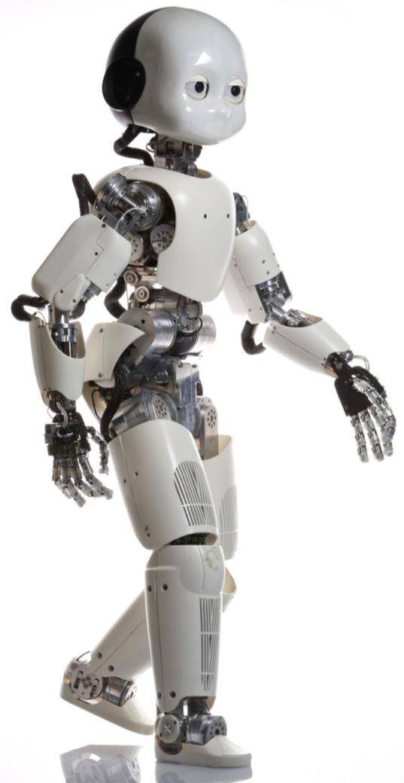
iCub – system architecture
EXTERNAL WORLD
HEAD
UPPERBODY
LOWERBODY

Slide 4
Icub - HEAD
COM Express Type 6 CPU
Intel CorCore i7
2 Ethernet LAN
Firewire Cameras
2x DragonFly 30fps 640x480
Inertial Measurement Unit
Accelerometers
Giroscopes
Audio input/output
Magnetometer
Connectech CG012
Wifi
1 Firewire Input (for cameras)
Audio Amplifier
Microphone and speaker
2 Microphones
1 Front Speaker
Facial Expressions
RGB Led Matrices
Motorized Eye leads
Motors and Motor Controller Cards
Six DC Motors
3 MC4-plus motor control board

Slide 5
Icub - upperbody
SKIN
Forearm 480 taxels
Force-Torque Sensors
2x 6 axis Force/Torque sensors (one for each arm)
Position Sensors
45 Absolute Position Sensors in the joints (analog or digital hall effect sensor) (12 bits/turn)
20 optical encoders for DC motors (10 to 12 bits/turn)
Motors and Motor Controller Cards
24 DC Motors in the forearm and in the hands
6 MC4-plus card
Upperarm 800 taxels
Palm 88 taxels
Fingertips 120 taxels
Torso 340 taxels
12x Joint Level Torque sensors
11 Brushless DC motors in the upperarm and torso
6 2FOC motor control card and 2 EMS4 boards
11 Reflective Encoder on the ROTOR shaft of the BLDC Motors (about 12 bits/turn)
5

Slide 6
Icub - LOWErbody
Force-Torque Sensors
2x 6 axis Force/Torque sensors (one for each arm)
Position Sensors
12 Absolute Position Sensors in the joints (digital hall effect sensor) (12 bits/turn)
Motors and Motor Controller Cards
12x Joint Level Torque sensors
12 Brushless DC motors
6 2FOC motor control card and 6 EMS4 boards
12 Reflective Encoder on the motor shaft of the BLDC Motors (12 bits/turn)
IMU XSENSE Mti-300-AHRS
SKIN
Legs 2620 taxels
6

Slide 7
Icub – external world
EXTERNAL WORLD
Power Supply
40V 30A
Ethernet Switch/Access point
Cluster
laptops
Server
GPU NVIDIA
Cloud Computing
Google services

Slide 8
Icub – ARChitecture

Slide 9
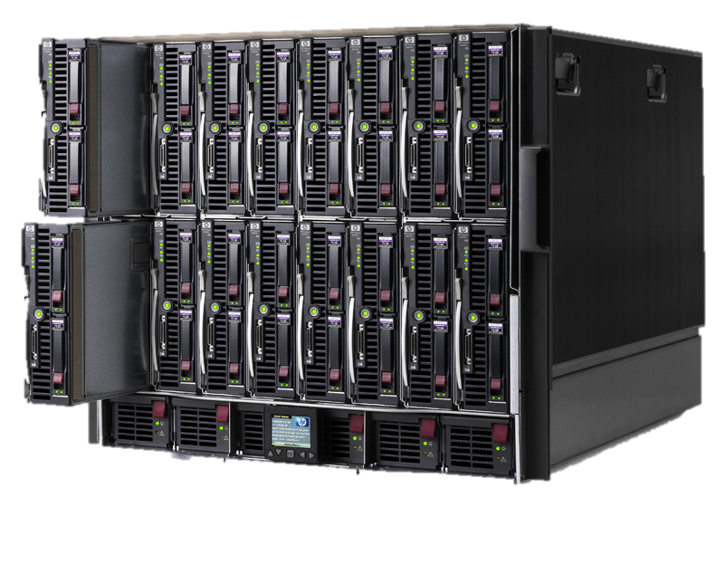
Icub 2.x - architecture
50–1kHz Ctrl Loops
10 – 100 Hz
1Gb Eth
COMExp
100Mb Eth

Slide 10

Icub 2.x - architecture
wifi
1kHz Ctrl Loops
COMExp
1Gb
100Mb Eth
1kHz Ctrl Loops
EMS
CAN1
CAN2
MC4-PLUS

Slide 11
Icub 2.x - architecture
Reflective
encoder
100Mb Eth
20-40kHz current loop
MOTOR
1kHz Ctrl Loops
2FOC
EMS
CAN1
2FOC
CAN2
Sensors
(force/torque, torque, skin)

Slide 12
Icub 2.x - architecture
Reflective
encoder
Harmonic
Drive
100Mb Eth
20-40kHz current loop
MOTOR
1kHz Ctrl Loops
2FOC
EMS
CAN1
2FOC
CAN2
Sensors
(force/torque, torque, skin)
12

Slide 13
Icub 2.x - architecture
100Mb Eth
Reflective
encoder
Harmonic
Drive
20-40kHz current loop
MOTOR
Joint
Absolute
Position
Sensor
1kHz Ctrl Loops
2FOC
EMS
CAN1
2FOC
CAN2
Sensors
(force/torque, torque, skin)
13

Slide 14
Icub 2.x - architecture
Reflective
encoder
Harmonic
Drive
100Mb Eth
20-40kHz current loop
MOTOR
Joint
Absolute
Sensor
1kHz Ctrl Loops
2FOC
Reflective
encoder
Harmonic
Drive
EMS
SPI
CAN1
MOTOR
Joint
Absolute
Sensor
2FOC
CAN2
Reflective
encoder
Harmonic
Drive
MOTOR
Joint
Absolute
Sensor
Reflective
encoder
Harmonic
Drive
MOTOR
Joint
Absolute
Sensor
14

Slide 15
Icub 2.x - architecture
100Mb Eth
Reflective
encoder
Harmonic
Drive
20-40kHz current loop
MOTOR
Joint
Absolute
Position
Sensor
1kHz Ctrl Loops
2FOC
EMS
SPI
CAN1
2FOC
CAN2
Sensors
(force/torque, torque, skin)

Slide 16
Icub 2.x - architecture
100Mb Eth
Reflective
encoder
Harmonic
Drive
20-40kHz current loop
MOTOR
Joint
Absolute
Position
Sensor
1kHz Ctrl Loops
2FOC
EMS
SPI
CAN1
Torque
sensor
2FOC
CAN2
Sensors
(force/torque, torque, skin)

Slide 17
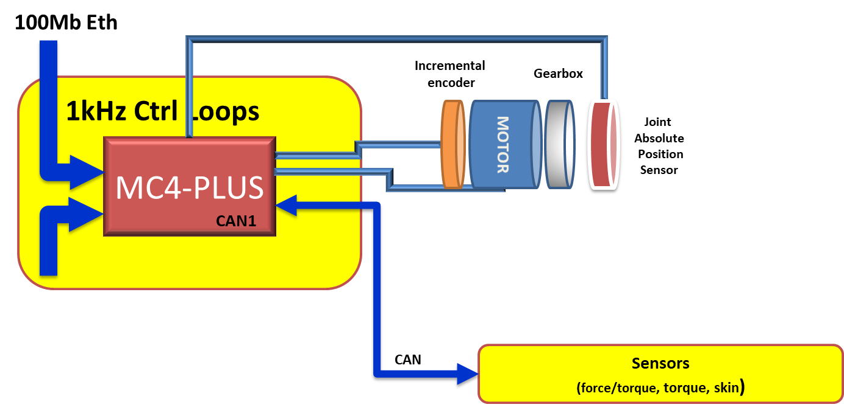
Icub 2.x - architecture

